Slide 1
ASIP Synthesis Methodology (ASSIST) Project
Prof. M. Balakrishnan
Department of Computer Science & Engineering
IIT Delhi
29th January 2002

Slide 2
Outline of Presentation
Introduction
Objectives of the project
Work done
Conclusion
Proposed Future Work
Publications

Slide 3
Project Details
ASSIST : ASIP Synthesis Methodology
Start Date : 12th May, 2000
Outline
Introduction
Objectives
Work done
Conclusion
Future work
Publications
Partner institutions
IIT Delhi
University of Dortmund
Faculty
Prof. M. Blalakrishnan
Prof. Anshul Kumar
Students
Manoj Kumar Jain Ph.D.
Rajeshwari M. Banakar Ph.D.
Vishal Bhatt M.Tech.
R. Ram Kumar B.Tech.
Vijay G. Prabakaran B.Tech.
Faculty
Prof. Peter Marwedel
Dr. Rainer Leupers
Students
Lars Wehmeyer Ph.D.
Stefan Steinke Ph.D.

Slide 4
Application Specific Instruction set Processor (ASIP)
Designed for specific application
Exploits special characteristics to meet the desired constraints
Efficient for applications like digital signal processing, automatic control systems, cellular phones

Slide 5
Objectives of the Project
Develop a methodology for exploring the design space in synthesizing an application specific instruction set processor (ASIP).
Outline
Introduction
Objectives
Work done
Conclusion
Future work
Publications
Combine strengths of two institutions
Synthesis and VLSI design strengths of IIT Delhi
Code Generation and architecture strengths of
University of Dortmund

Slide 6
Work done
Survey
Methodology
Register Size Evaluation
Register Windows Evaluation
Cache v/s Scratchpad
Leon Processor Synthesis
Outline
Introduction
Objectives
Work done
Conclusion
Future work
Publications

Slide 7
ASSIST: Flow Diagram
Application &
Design Constraints
Application Analysis
Area and
Clock period
data
Architectural Design Space
Exploration
Code Synthesis
Hardware Synthesis
Object Code
Processor Description

Slide 8
ASSIST: Flow Diagram
Register size evaluation
Register windows exploration
Cache-Scratchpad
Application &
Design Constraints
Application Analysis
Area and
Clock period
data
Architectural Design Space
Exploration
Code Synthesis
Hardware Synthesis
Object Code
Processor Description

Slide 9
ASSIST: Flow Diagram
Register size evaluation
Register windows exploration
Cache-Scratchpad
Application &
Design Constraints
Application Analysis
Leon Processor Syn.
Area and
Clock period
data
Architectural Design Space
Exploration
Code Synthesis
Hardware Synthesis
Object Code
Processor Description

Slide 10
Register Size Evaluation: Problem Definition
Work done
Survey
Methodology
Register Size
Register Windows
Cache/ Scratchpad
Leon Proc. Synth.
Study the impact of changing the number of
registers on
Performance (# cycles)
Power
Energy
Code size

Slide 11
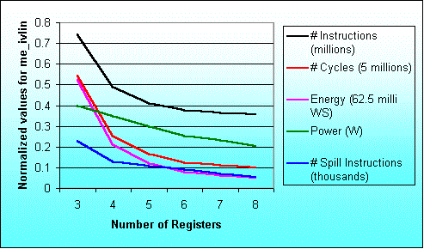
Result for the program me_ivlin
knee due to exec. time reduction
knee due to power saving

Slide 12
Register Windows Evaluation: Problem Definition
Work done
Survey
Methodology
Register Size
Register Windows
Cache/ Scratchpad
Leon Proc. Synth.
Performance analysis for the
ASIP parameter,
number of register windows

Slide 13
Overlapping Register
Overlapping Registers
W3 outs
W0 ins
W3 locals
W2 outs
W3 ins
W0 locals
W2 locals
W0 outs
W1 ins
W1 outs
W2 ins
W1 locals

Slide 14
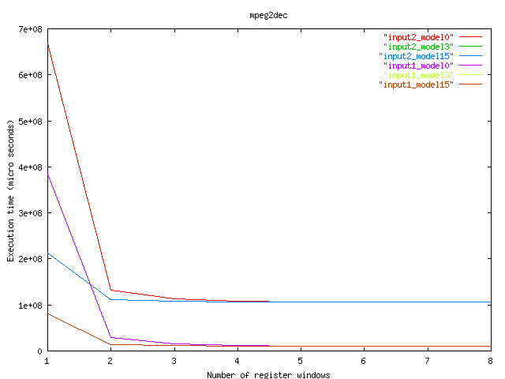
Execution time for MPEG Decoder

Slide 15
Cache v/s Scratchpad : Objectives
Develop a systematic framework to evaluate area, performance and energy of cache/scratch pad based systems
Develop the area model for varying sizes of cache/scratchpad memory
Performance model
Energy model
Work done
Survey
Methodology
Register Size
Register Windows
Cache/ Scratchpad
Leon Proc. Synth.

Slide 16
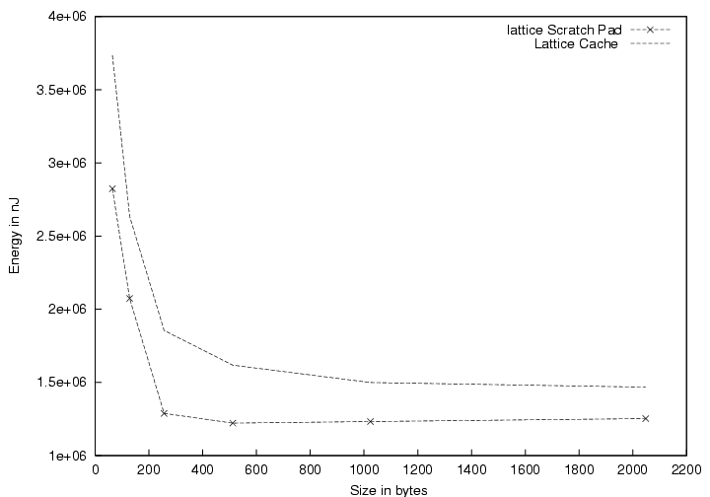
Energy Consumption for lattice filter
Cache
Scratch pad

Slide 17
Leon Synthesis Objectives
Synthesize Leon processor for different configurations
Generate a database of area and clock period for different configurations to assist in ASIP design space exploration
Identify and incorporate more architectural features
Work done
Survey
Methodology
Register Size
Register Windows
Cache/ Scratchpad
Leon Proc. Synth.

Slide 18
Conclusion
Impact of register file size variation in ARM and LEON processor on performance, code size, power and energy
Impact of number of register windows on performance
Trade off between scratch-pad and cache memories for ARM and LEON processor
Area and clock period results by various LEON configurations
Outline
Introduction
Objectives
Work done
Conclusion
Future work
Publications

Slide 19
Proposed Future Work
An extensive case study to illustrate the methodology
Design space exploration with ASSET (framework at IIT Delhi) and validation using the compile-simulation technique currently being used
FPGA implementation of LEON processor to validate the methodology
Outline
Introduction
Objectives
Work done
Conclusion
Future work
Publications

Slide 20
Publications (Journal and Reviewed Conferences Papers
Jain, M.K.; Balakrishnan, M.; Anshul Kumar : “ASIP Design Methodologies : Survey and Issues”, VLSI 2001.
Jain, M.K.; Wehmeyer, L.; Steinke, S.; Marwedel, P.; Balakrishnan, M. : “Evaluating Register File Size in ASIP Synthesis”, COSES 2001.
Wehmeyer, L.; Jain, M.K.; Steinke, S.; Marwedel, P.; Balakrishnan, M. : “Analysis of the Influence of the Register File Size on Energy Consumption, Code Size and Execution Time”, IEEE TCAD, vol. 20, no. 11, Nov. 2001.
Bhatt, V.; Balakrishnan, M.; Anshul Kumar : “Register Windows Analysis in ASIPs”, VLSI 2002.
Outline
Introduction
Objectives
Work done
Conclusion
Future work
Publications

Slide 21
Publications
(Conferences Papers)
Wehmeyer, L.; Jain, M.K.; Steinke, S.; Marwedel, P.; Balakrishnan, M. : “Using a retargetable, Energy aware Compiler Framework for Deciding Number of Registers in ASIP Design”, Fifth International Workshop on Software and Compilers for Embedded Systems, SCOPES 2001, 20-22 March, 2001, St. Goar, Germany.
Banakar, R.; Bose, R.; Balakrishnan, M. : “Low Power Design: Abstraction levels and RT level design techniques”, VLSI Design and Test Workshop, VDAT 2001, Aug. 2001, Banglore, India.

Slide 22
Publications (Technical Reports)
Jain, M. K. : “ASIP Design Methodologies : Survey and Issues”, TR #2000/24, Embedded Systems Project, Department of Computer Science and Engineering, IIT Delhi.
Jain M. K., Wehmeyer, L.; Marwedel, P.; Balakrishnan, M. : “Register File Synthesis in ASIP Design”, TR #2000/746, Department of CS XII, University of Dortmund, Germany.
Kumar, R. R.; Prabakaran, V. G. : “Application Specific Instruction Set Processor Synthesis and Estimation”, TR # 2000/29 (B.Tech. Project report), Embedded Systems Project, Department of Computer Science and Engineering, IIT Delhi.
Bhatt, V. V. : “Register Window Analysis in ASIPs”, TR #2000/36 (M.Tech. Project Report), Embedded Systems Project, Department of Computer Science and Engineering, IIT Delhi.
Banakar, B.; Steinke, S.; Lee, B. S.; Balakrishnan, M.; Marwedel, P. : “Comparison of Cache and Scratch-Pad based memory Systems with respect to Performance, Area and Energy Consumption”, TR #2001/762, Department of CS XII, University of Dortmund, Germany.

Slide 23
ASIP Synthesis and Retargetable Code Generation Workshop
Jan. 2, 2002 to Jan. 4, 2002
IIT Delhi
The topics covered :
Memory Optimizations
Architectural Exploration for
Programmable Embedded
Systems
VLIW Synthesis
Retargetable Compiler
Technology
Code Generation Techniques
The Speakers :
Prof. M. Balakrishnan, IIT Delhi
Prof. Anshul Kumar, IIT Delhi
Prof. Paolo Ienne, EPFL
Dr. Preeti Ranjan Panda, Synopsis Inc.
Prof. Nikil Dutt, UC Irvine
Prof. Peter Marwedel, Univ. of Dortmund
Dr. Uday Khedker, IIT Bombay
Dr. Rainer Leupers, Univ. of Dortmund

Slide 24
Thanks

Slide 25
Methodology : ASSIST Flow Diagram
Application
Constraints
Profiler
Parameter
Extractor
Application Parameters
Basic
Processor
Config.
Component
Power
models
Configuration
Selector
Processor
Pipeline +
models
# of clocks
Estimator
Power
Estimator
Area and
Clock Period
Estimator
Area and
Clock period
data
Processor
Configurations
Work done
Survey
Methodology
Register Size
Register Windows
Cache/ Scratchpad
Leon Proc. Synth.
Design Space Explorer
Retargetable
Compiler Generator
Synthesizable
VHDL Generator
ASIP Compiler
Synthesizable
VHDL

